Slide 1

Evolution of global biodiversity
Petr Keil

Slide 2
How biodiversity came to be?
Biodiversity through geological time

Slide 3
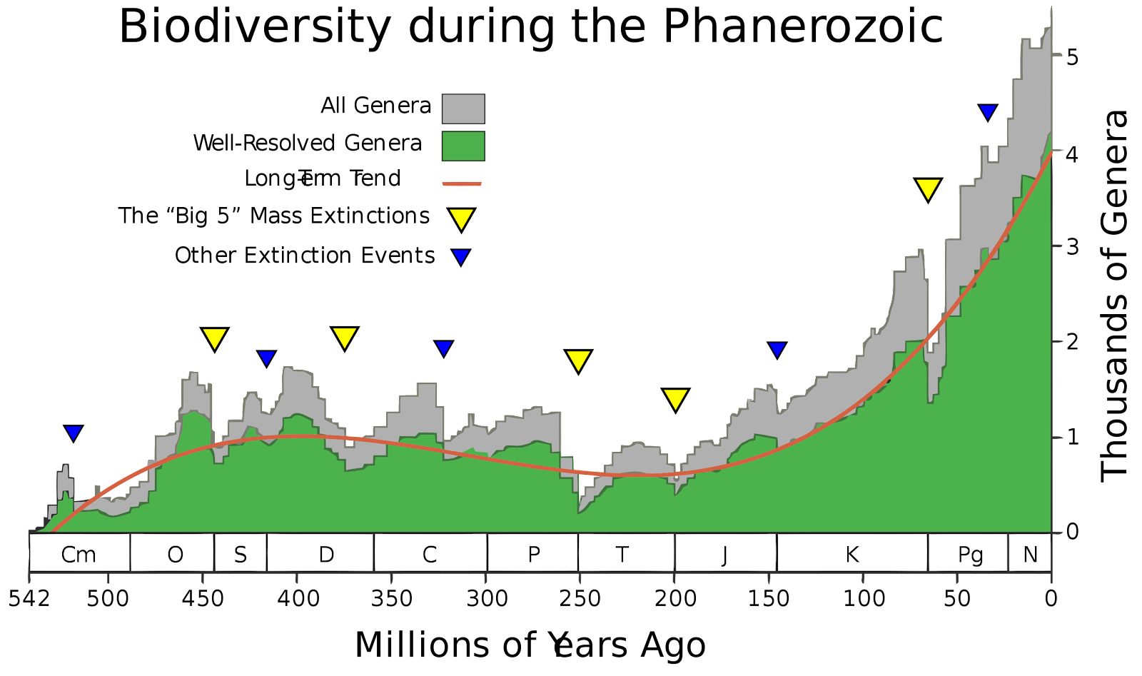
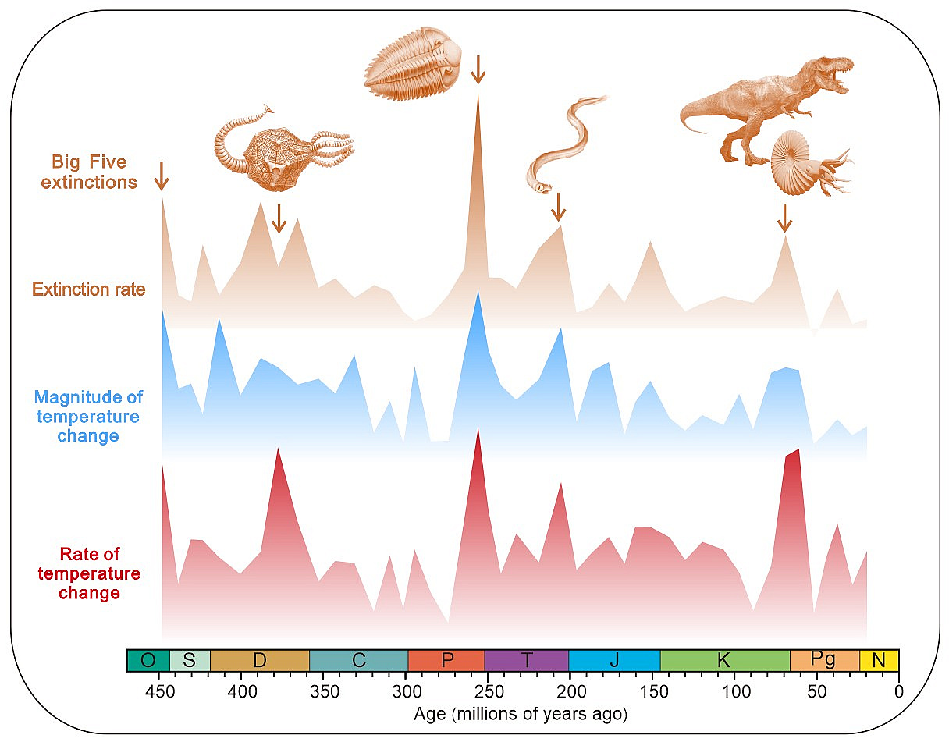
Biodiversity through geological time
Causes:
Giant volcanic eruptions
Asteroid impact
Sea level falls
Climate cooling/warming
Anoxia
Secret: Dinosaurs are still among us, they are just much smaller and have feathers

Slide 4
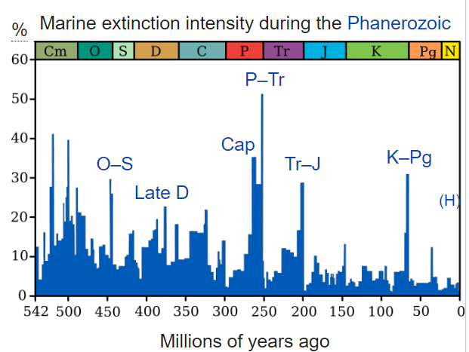
Magnitude of extinction events in % - background extinction rate
When both marine and terrestrial taxa considered, then it’s roughly 30-80% of extinct genera per big event
The usual background rate is ca 0.1-1 per million species-year (for fossilizing organisms)

Slide 5
The current extinction rate vs paleontological background rates
Díaz & Malhi (2022) Annu. Rev. Environ. Res.

Slide 6
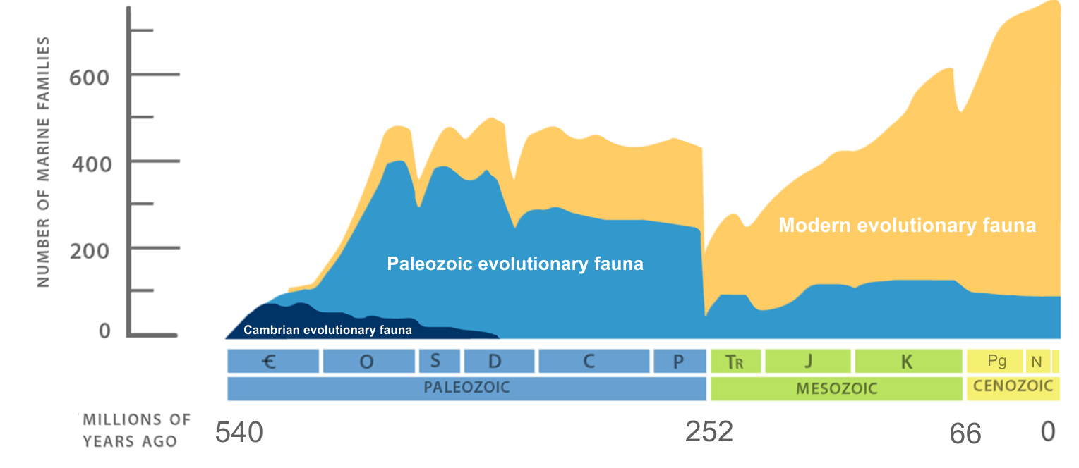
Increases of diversity after extinction events
Diversification = speciation – extinction
Radiation = rapid diversification from a small number of taxa

Slide 7
How new species emerge
Speciation and natural selection

Slide 8
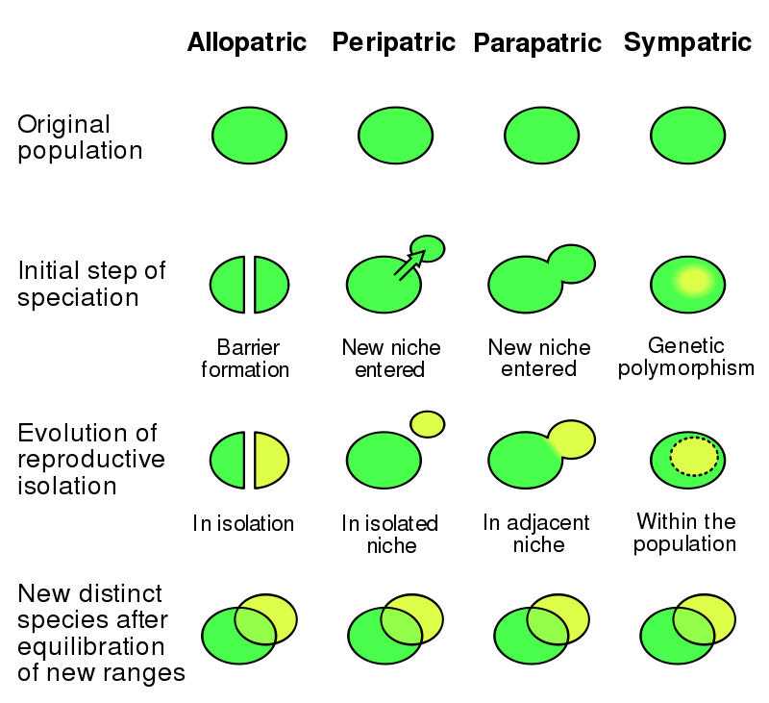
Speciation = how new species are created
This can only work when species change in time!
This happens through genetic drift (mutations), or adaptation to new environment

Slide 9
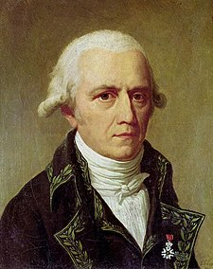
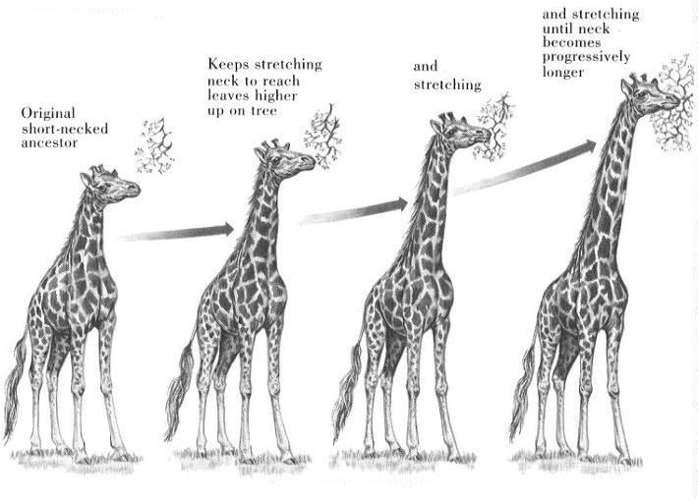
Species change, according to Lamarck
Jean Baptiste Lamarck (1744 – 1829)

Slide 10
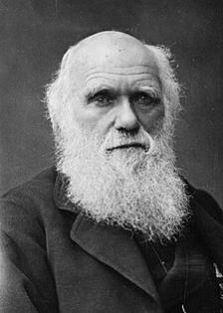
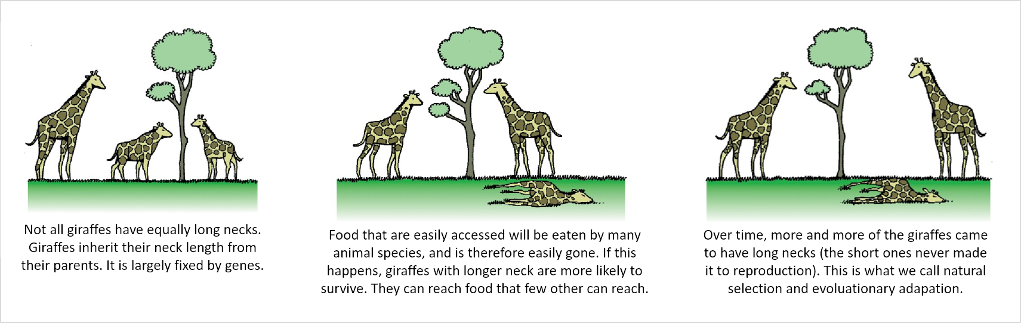
Species change, according to Darwin: natural selection
Natural selection is passive (the environment selects) and acts over generations, not during lifetime.
Darwin (1859) On the Origin of Species.

Slide 11
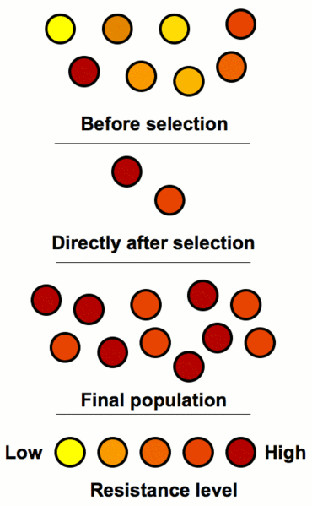
Adaptation
Adaptation
dynamic process of natural selection that fits organisms to their environment, enhancing their fitness.
state reached by the population during that process.
phenotypic trait or adaptive trait, with a functional role in each individual organism, that is maintained and has evolved through natural selection.
Organisms do not adapt during their lifetime, the merely reproduce and die

Slide 12
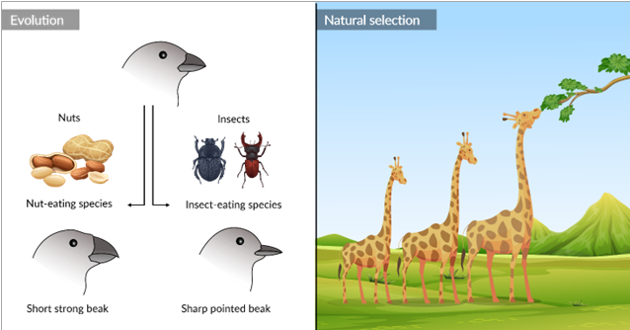
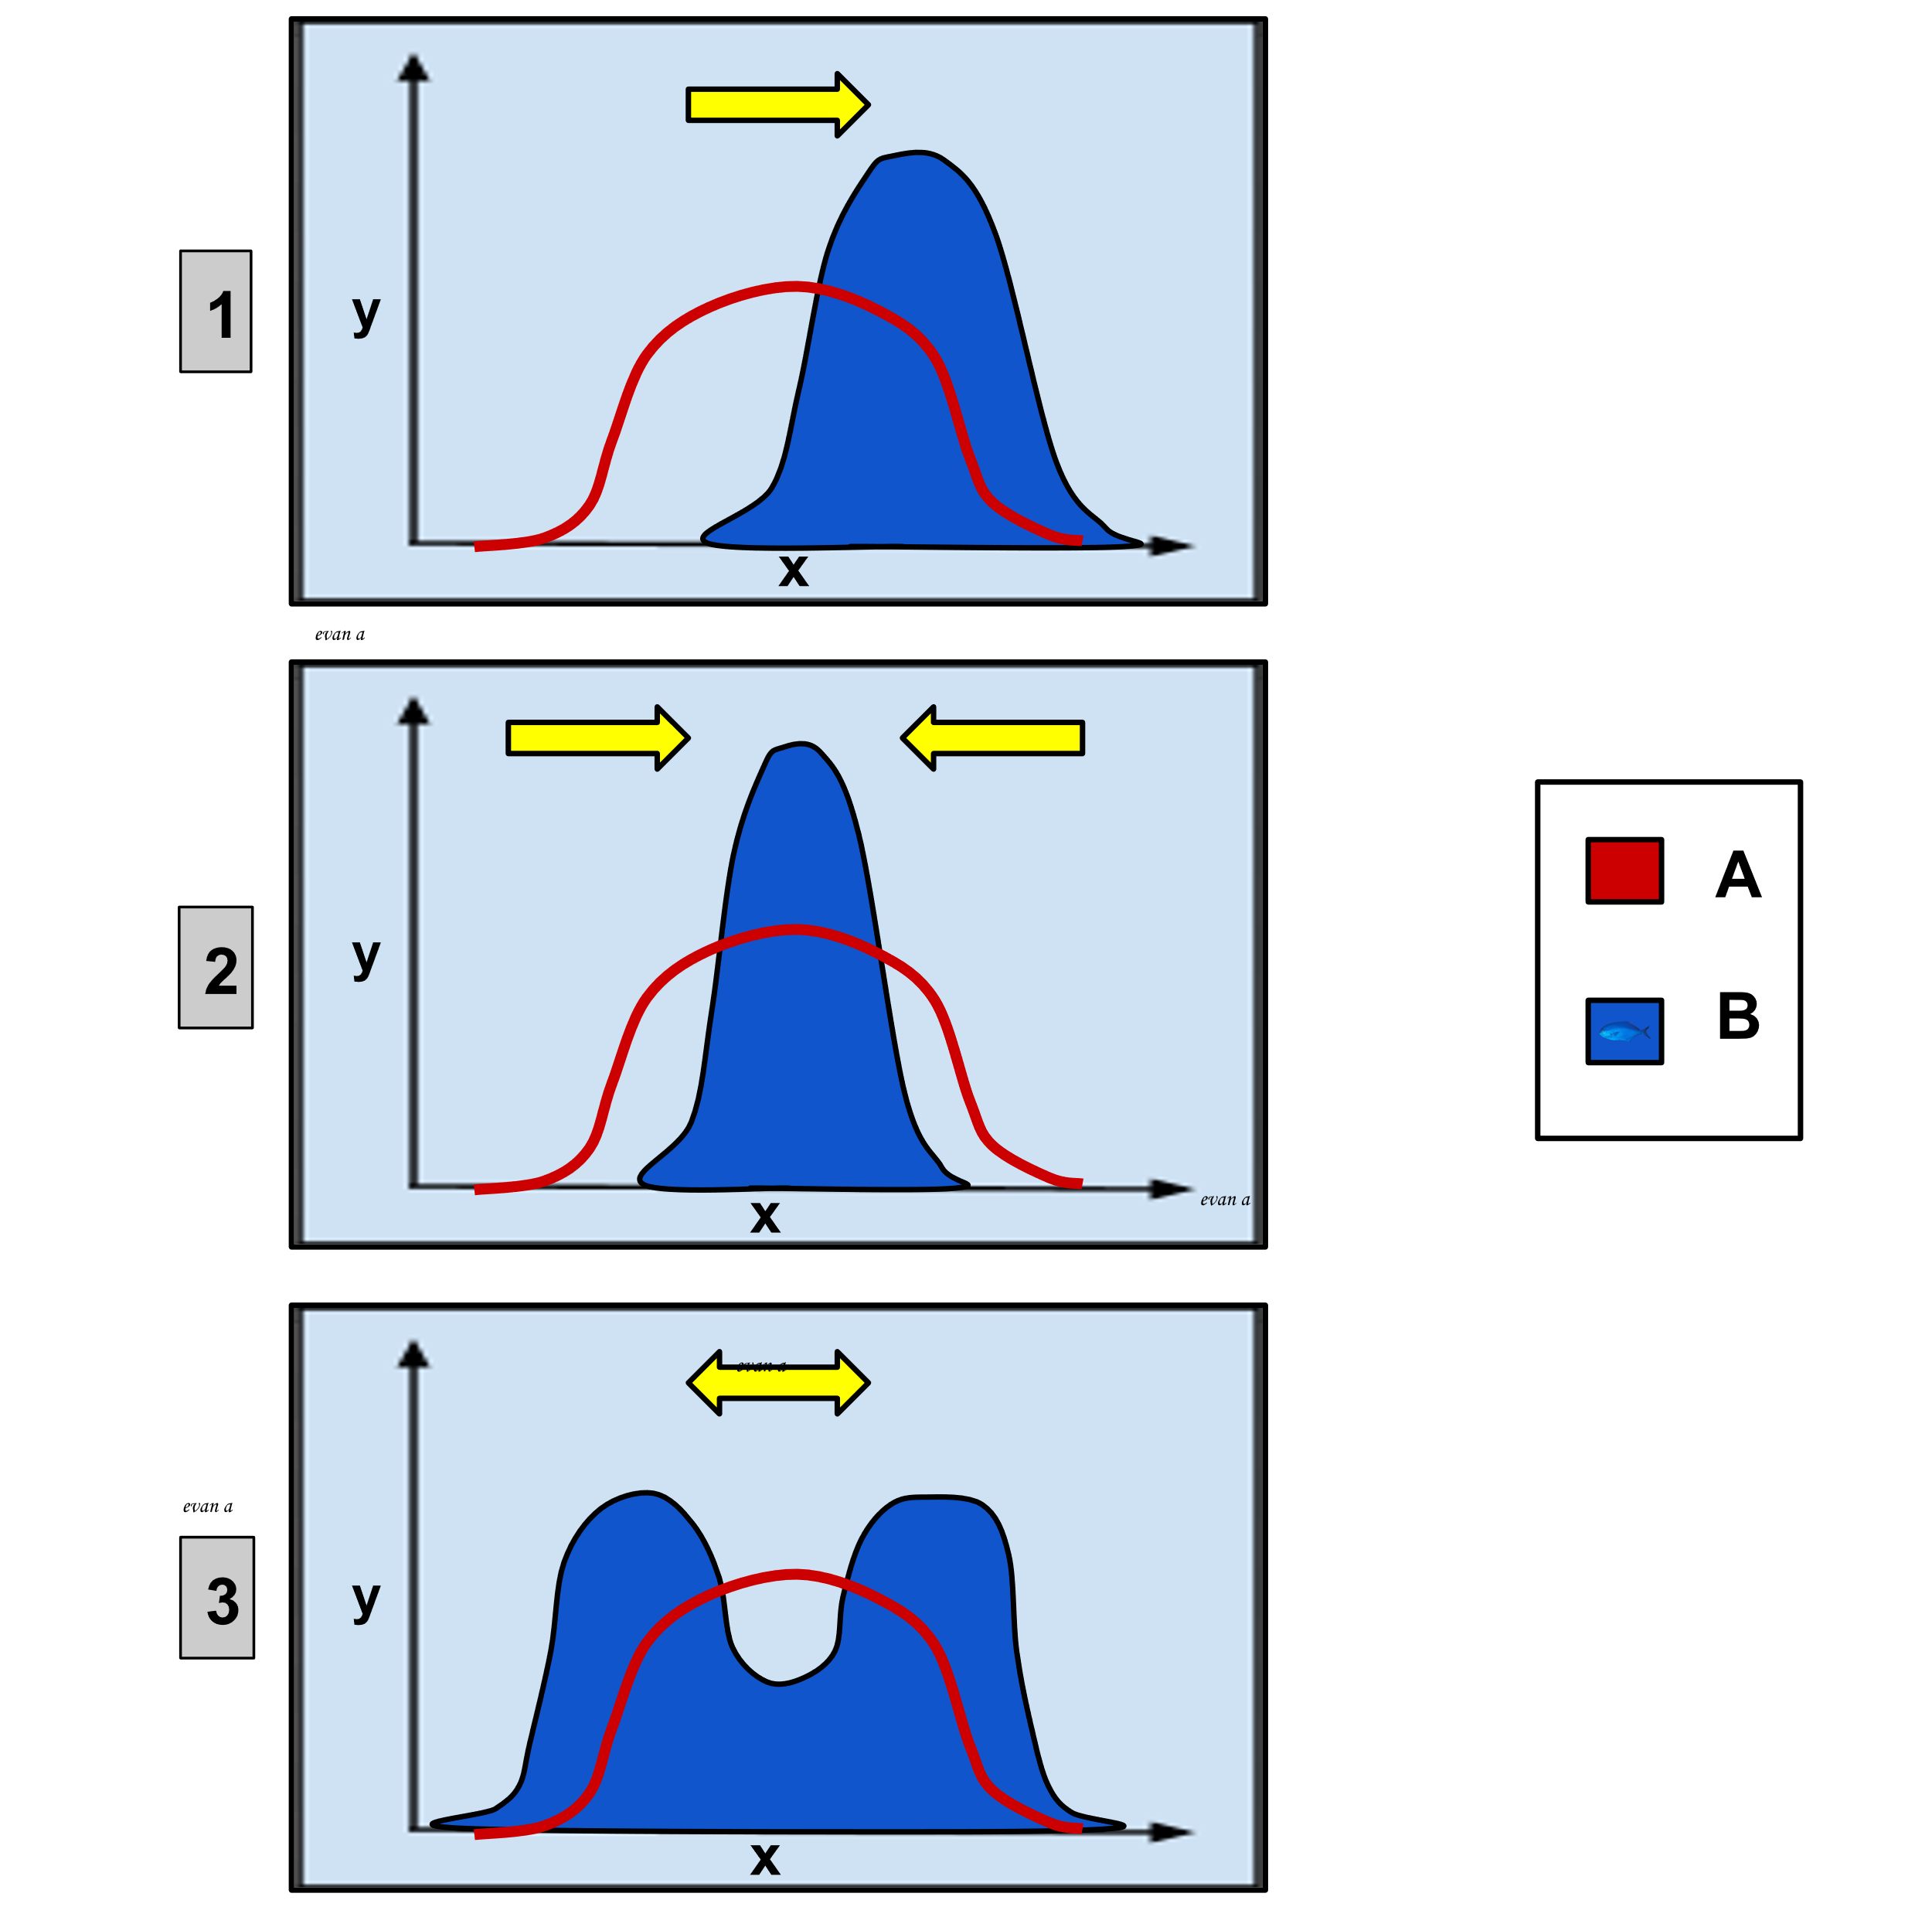
Types of selection
Lamarck’s giraffes
Directional selection
Stabilizing selection
Darwin’s finches
Disruptive selection

Slide 13
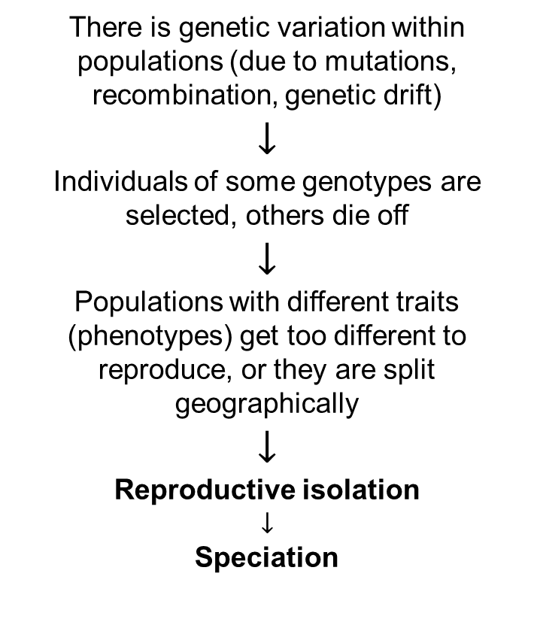
From natural selection to speciation
Lamarck’s giraffes
There is genetic variation within populations (due to mutations, recombination, genetic drift)
$$↓$$
Individuals of some genotypes are selected, others die off
$$↓$$
Populations with different traits (phenotypes) get too different to reproduce, or they are split geographically
$$↓$$
Reproductive isolation
$$↓$$
Speciation

Slide 14
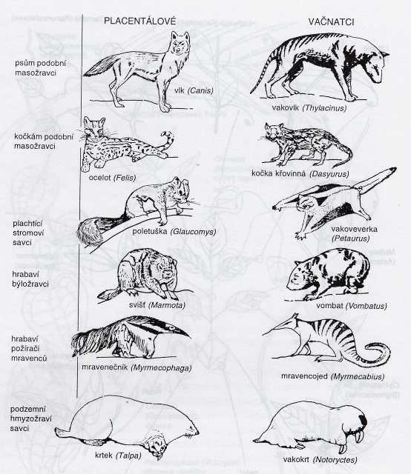
What supports this idea of evolution?
Hierarchical structure of similarity in nature.
The existence of homologies and parallel evolution
Fossils.
Imprints in embryonal development.
Imperfect nature of some traits.
Non-random distribution of organisms.
We can observe it in action right now.
It can also be re-created by humans, either experimentally (on drosophillas, bacteria, …), or by breeding

Slide 15
Phylogeny
The genealogy of species

Slide 16

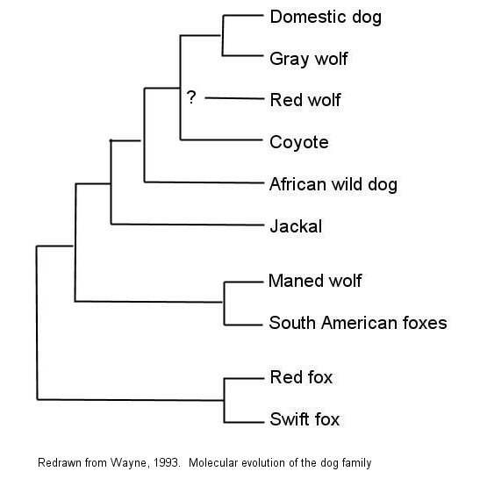
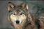
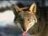
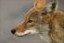
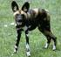
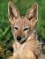
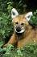
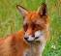

Phylogeny – the tree of life
Canid phylogeny:
Taxonomie – hierarchická klasifikace organismů
Fylogeneze – kmenový vývoj organismů v historickém (evolučním) sledu
Anageneze (neboli mikroevoluce) – evoluční změny uvnitř druhu
Speciace (neboli makroevoluce neboli kladogeneze) – štěpení linií v samostatné druhy

Slide 17
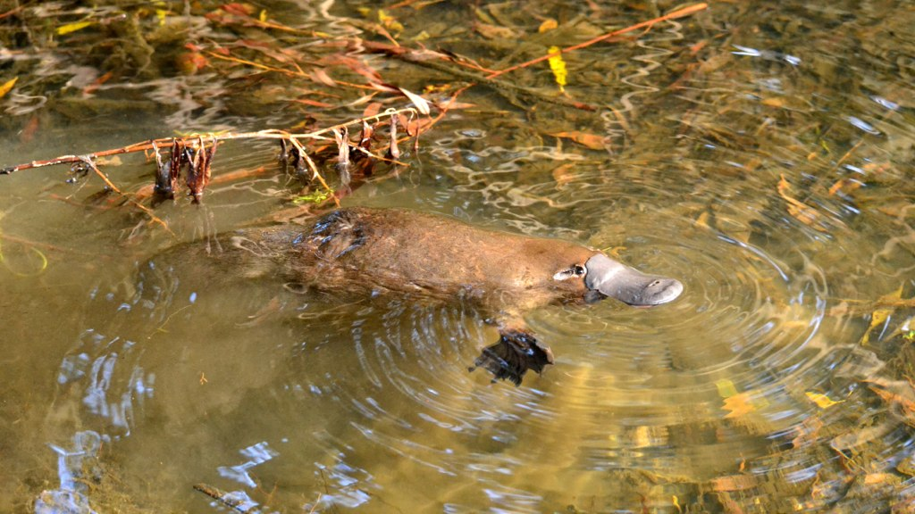
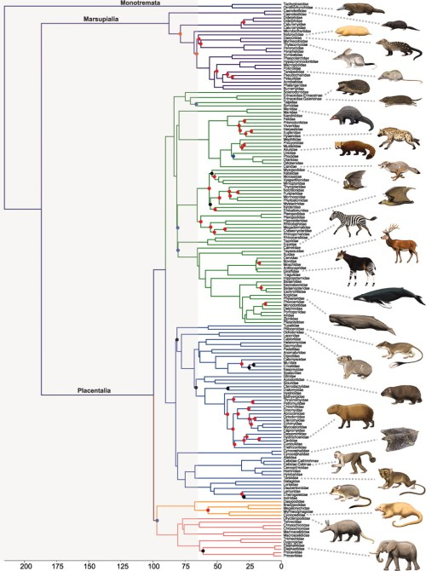
A clade and cladistics (the science of clades)
Monophyletic clade – a group of species that share the same common ancestor
Meredith et al. 2011 Science

Slide 18
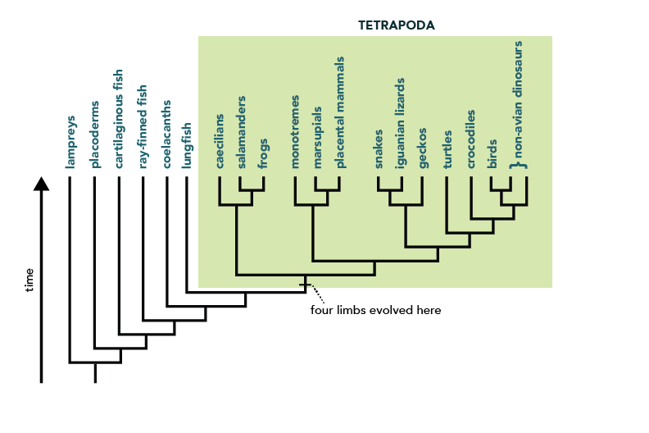
How do we get a phylogeny?
We use homologous characters — characters in different organisms that are similar because they were inherited from a common ancestor that also had that character. An example of homologous characters is the four limbs of tetrapods. Birds, bats, mice, and crocodiles all have four limbs. Sharks and bony fish do not. The ancestor of tetrapods evolved four limbs, and its descendents have inherited that feature — so the presence of four limbs is a homology.
These can be morphological, or molecular.
evolution.berkeley.edu

Slide 19
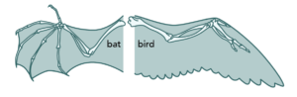
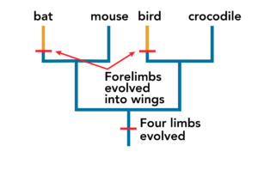
Do not confuse homology with analogy
Bat wings consist of flaps of skin stretched between the bones of the fingers and arm. Bird wings consist of feathers extending all along the arm. These structural dissimilarities suggest that bird wings and bat wings were not inherited from a common ancestor with wings.
Wings in bats and have separate evolutionary origins, but the same function.
evolution.berkeley.edu

Slide 20
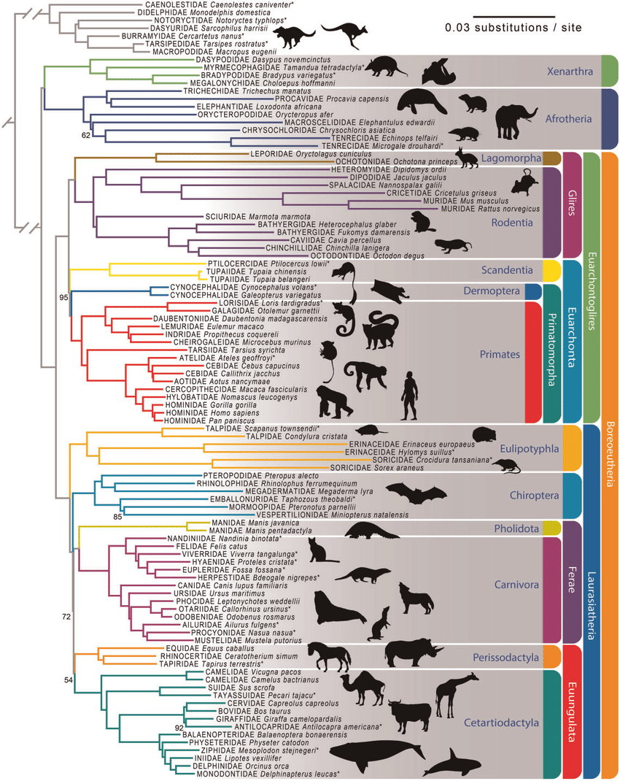
Phylogeny – the tree of life
Esselstyn et al. (2017) GBE

Slide 21
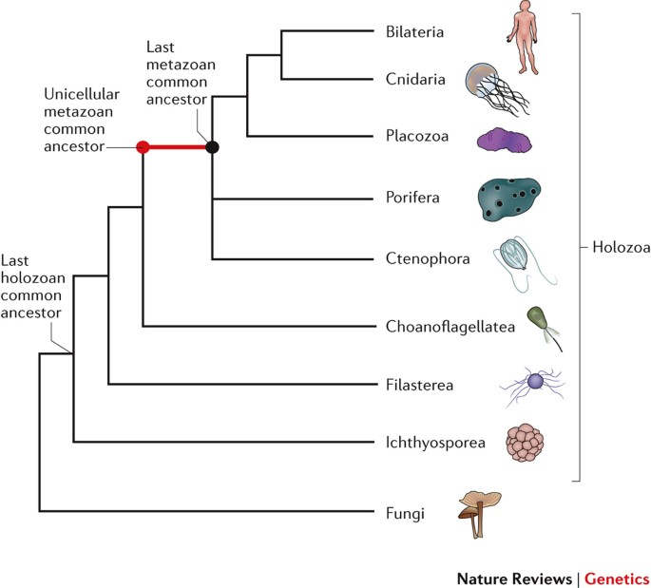
Phylogeny – the tree of life

Slide 22
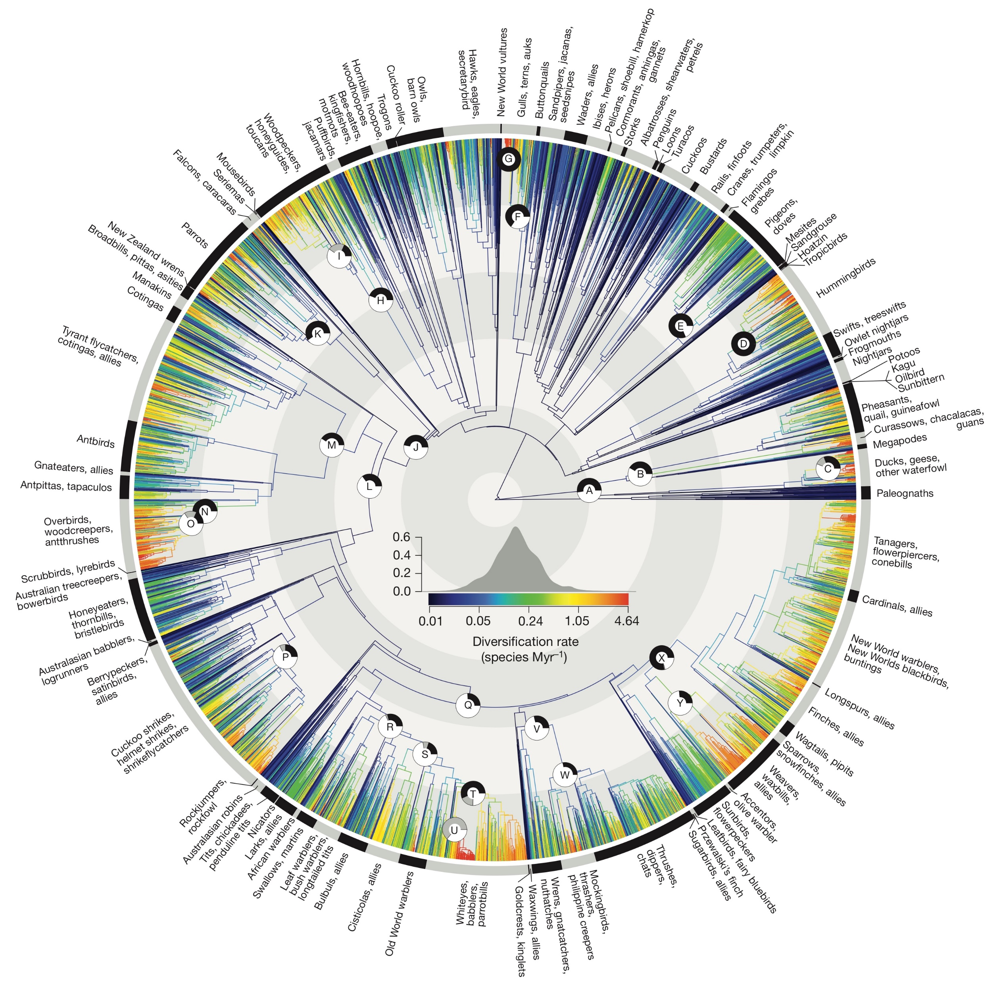
Phylogeny – the tree of life
Jetz et al. (2012) Nature

Slide 23
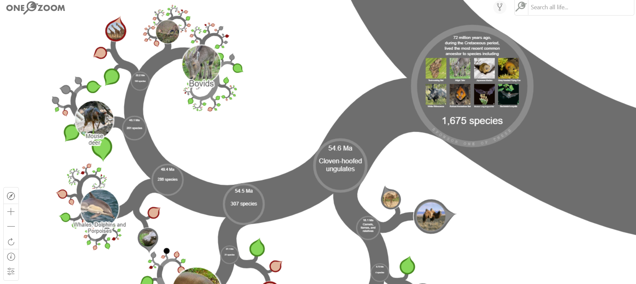
Phylogeny – the tree of life
https://www.onezoom.org/

Slide 24
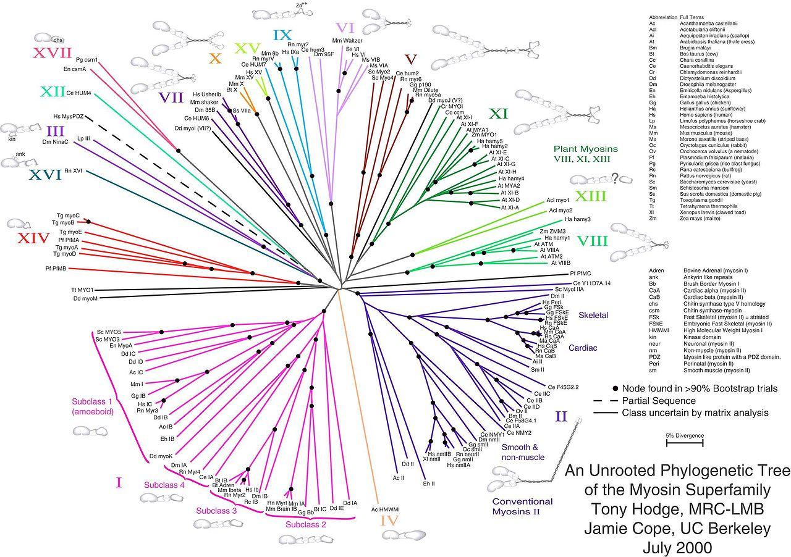
Types of phylogeny – unrooted tree
An unrooted tree shows relatedness among taxa, without assuming who came to existence first

Slide 25
Types of phylogeny - cladogram
Canid phylogeny:
A cladogram only represents a branching pattern

Slide 26
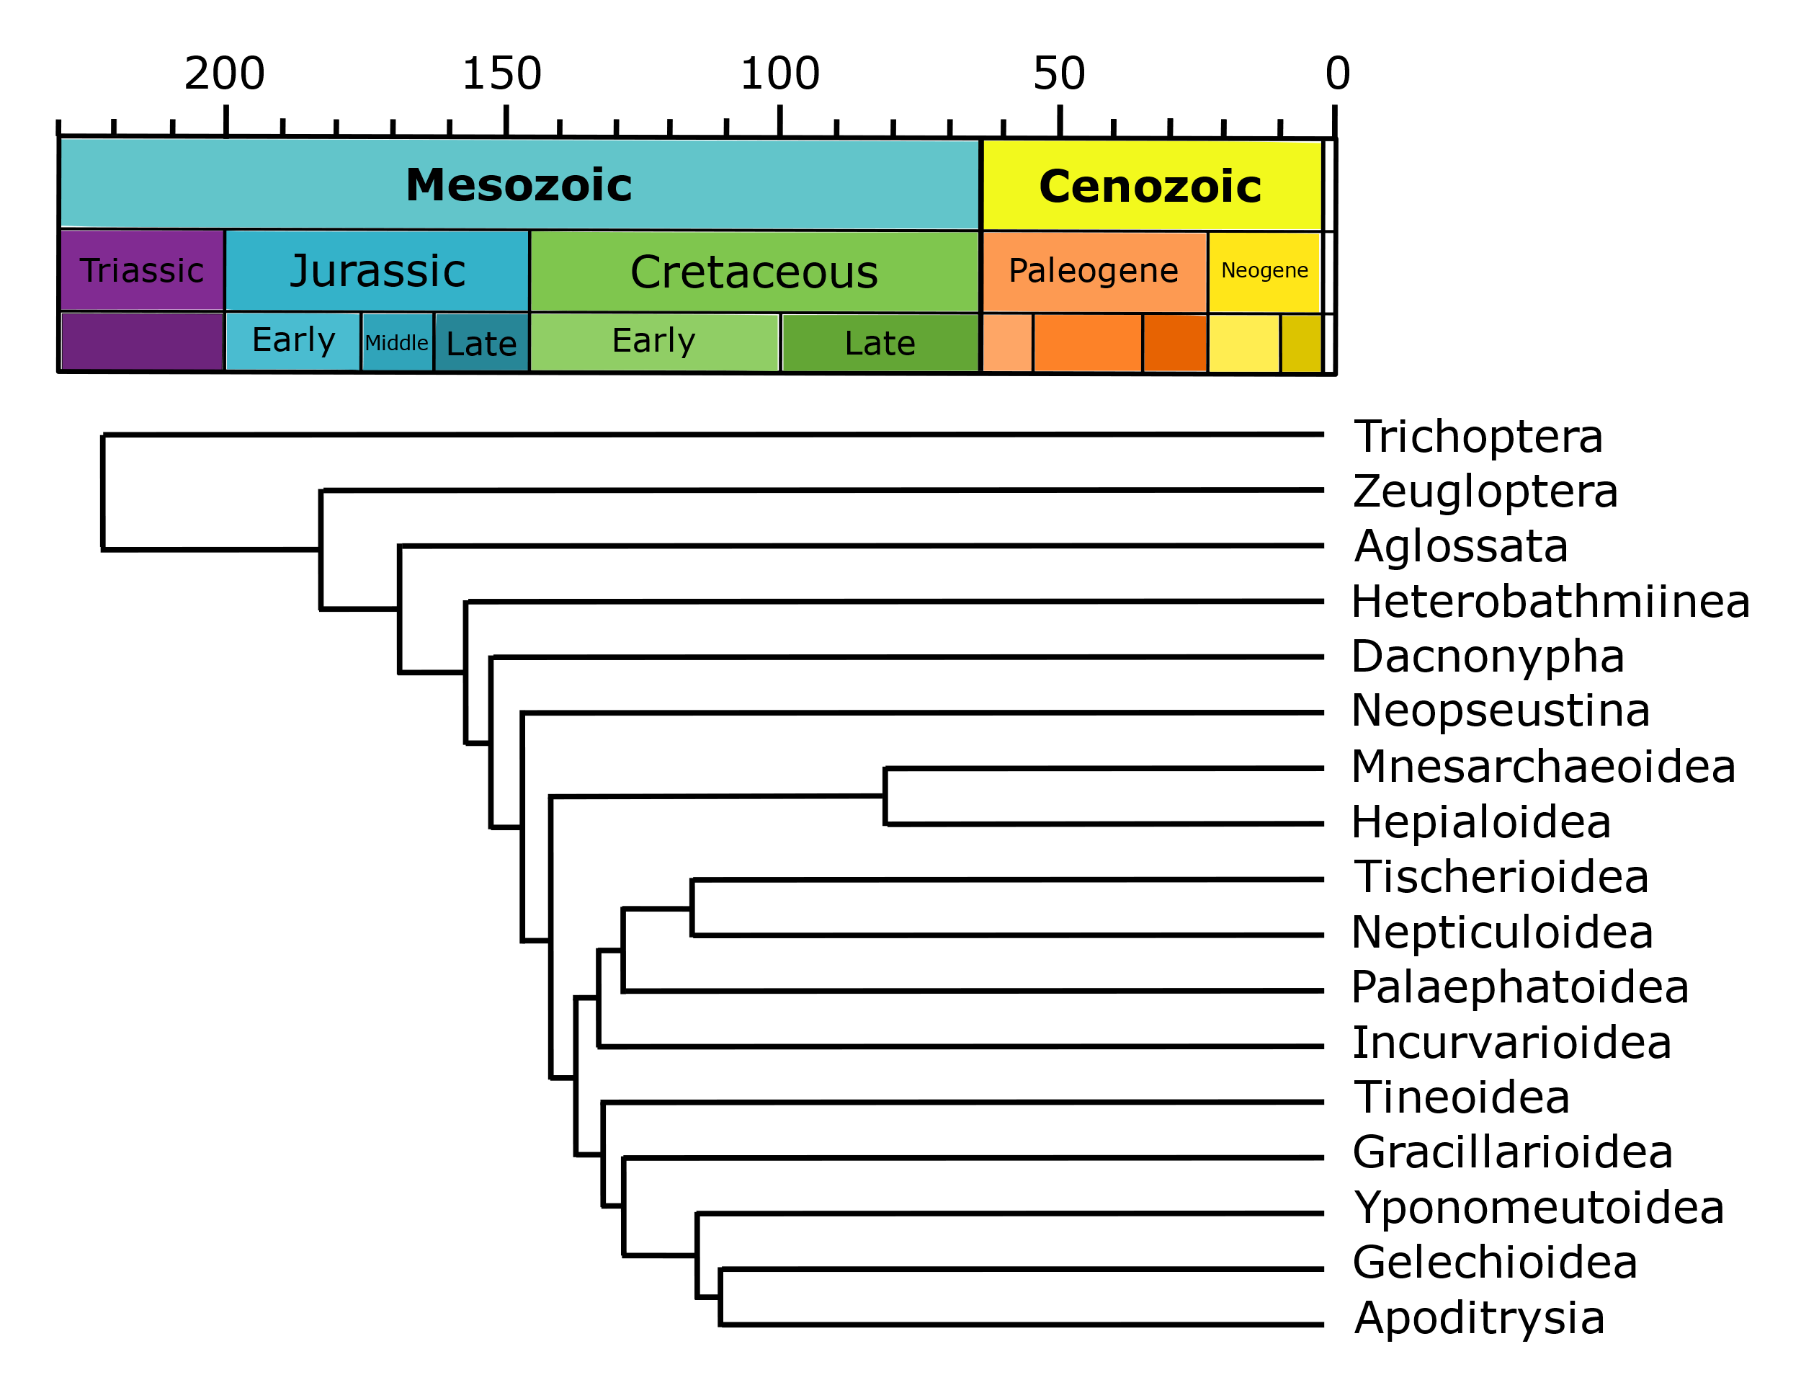
Types of phylogeny – phylogram or chronogram
A phylogram has branch lengths proportional to their age.
A chronogram has exact ages of the branches.
Labnadeira 1994 PNAS

Slide 27
What you should remember
The number of taxa steadily increased through geological time
There have been 5 major extinction events (the “big five”) and we are likely in the midst of another one
Apart from extinction, the other process generating biodiversity is speciation
You should know the principle of Darwinian natural selection, and how it’s connected to speciation
Evolutionary relationships among organisms are represented by a phylogeny a.k.a. phylogenetic tree

Slide 28
What are phylogenies good for in ecology and conservation?

Slide 29
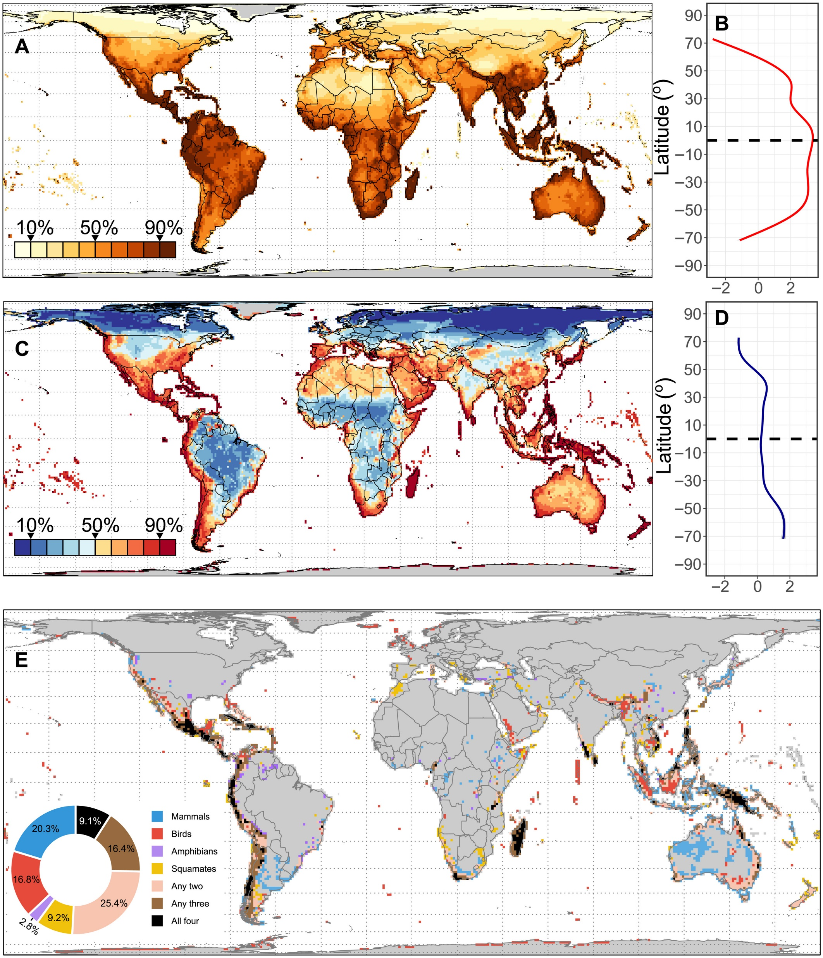
Phylogenetic endemism and evolutionary distinctness
Global patterns of phylogenetic endemism and congruence of phylogenetic endemism hotspots for tetrapods.
(A) Spatial and (B) latitudinal patterns of phylogenetic endemism (uncorrected for richness; red). (C) Spatial and (D) latitudinal patterns of phylogenetic endemism (corrected for richness; blue). Note that the values of phylogenetic endemism uncorrected for richness are log-transformed in graph (B), and the fitted line is from loess regression. (E) Congruence map of phylogenetic endemism hotspots.
Murali et al. (2021) Science Advances

Slide 30
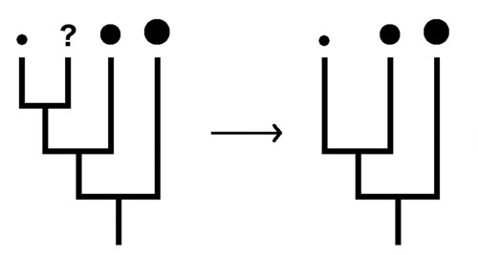
Phylogenetic imputation
We can guess values of traits in species for which we have no information.
Examples:
- body size
- thermal requirements
- conservation threat status
Jetz & Freckleton (2015) Philos Trans R Soc B

Slide 31
Mapping diversification rates
Jetz et al. (2012) Nature

Slide 32
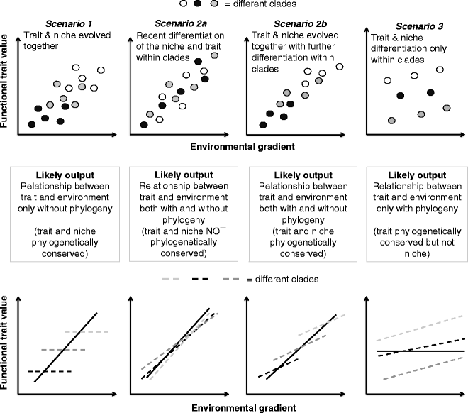
Phylogenetic comparative methods
De Bello et al. 2015 Folia Geobotanica

Slide 33
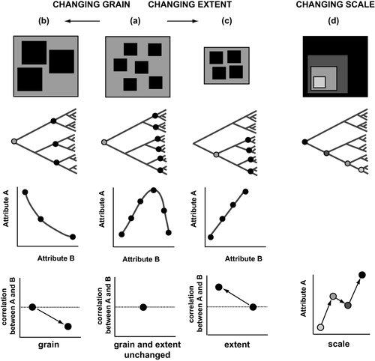
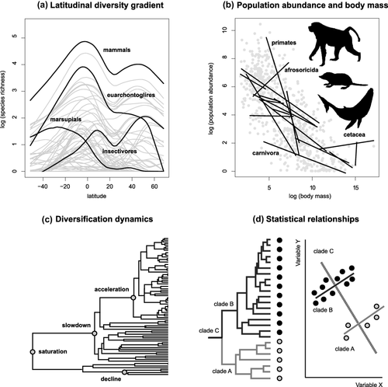
Phylogenetic scale
Graham et al. 2018 Global Ecology and Biogeography

Slide 34
How much biodiversity is now on Earth
The creator has an inordinate fondness of beetles (Charles Darwin)

Slide 35
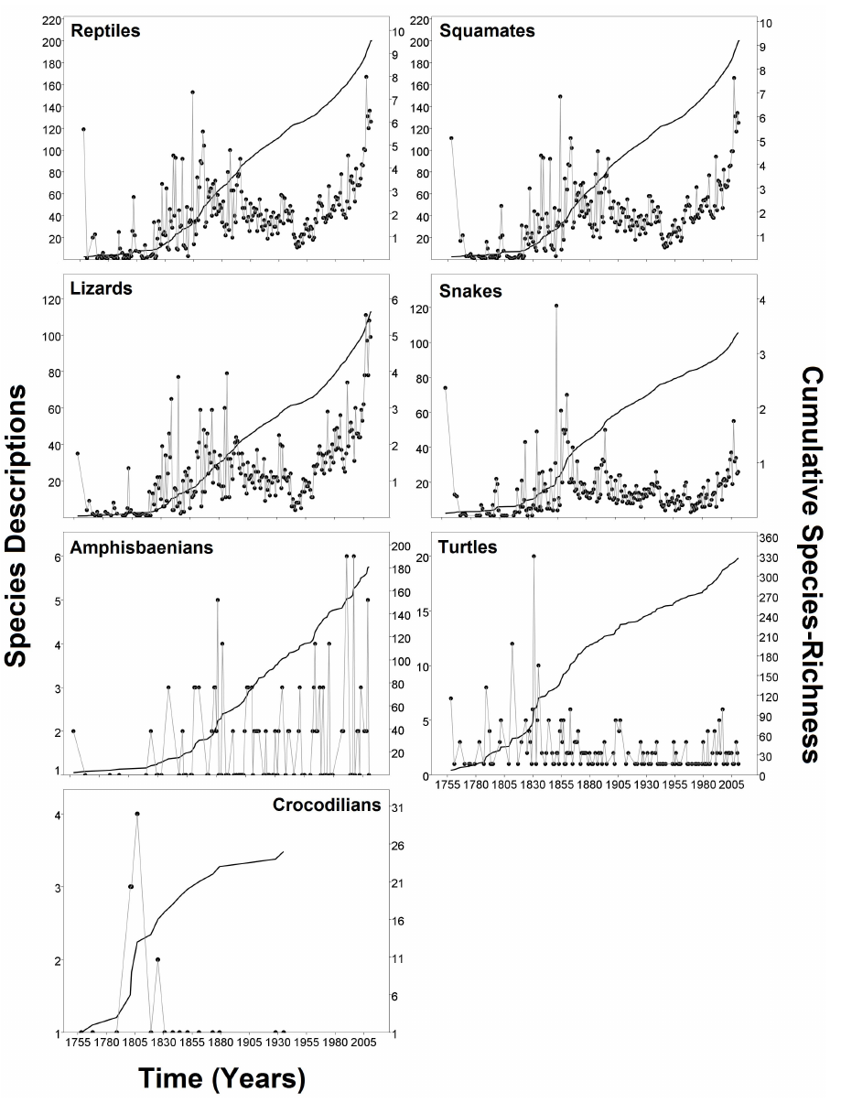
How do we know the total number of species?
Extrapolating species descriptions through time
Pincheira and Donoso (2013) PlosONE

Slide 36
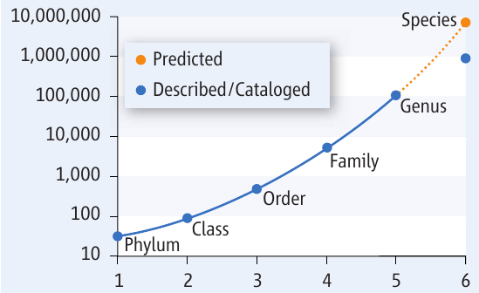
How do we know the total number of species?
Extrapolating numbers of species per higher taxonomic units
Strain (2011) Science

Slide 37
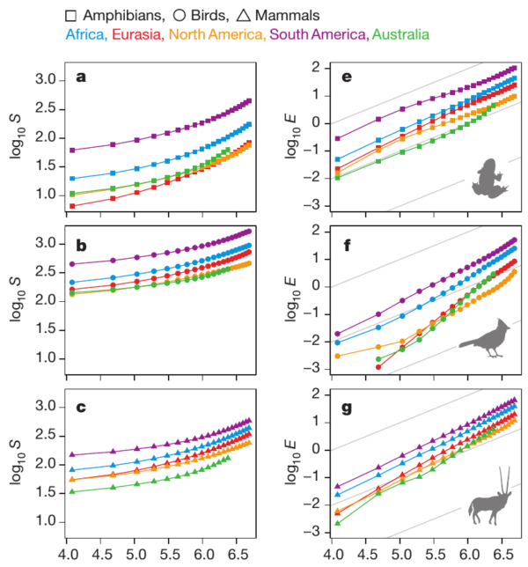
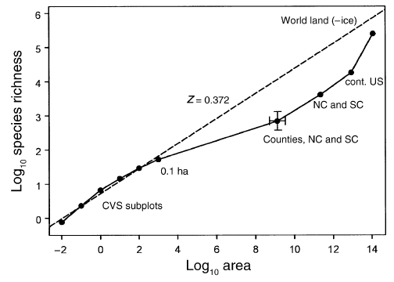
How do we know the total number of species?
Extrapolating species-area relationship
Fridley (2005) Ecology
Storch et al. (2012) Nature

Slide 38
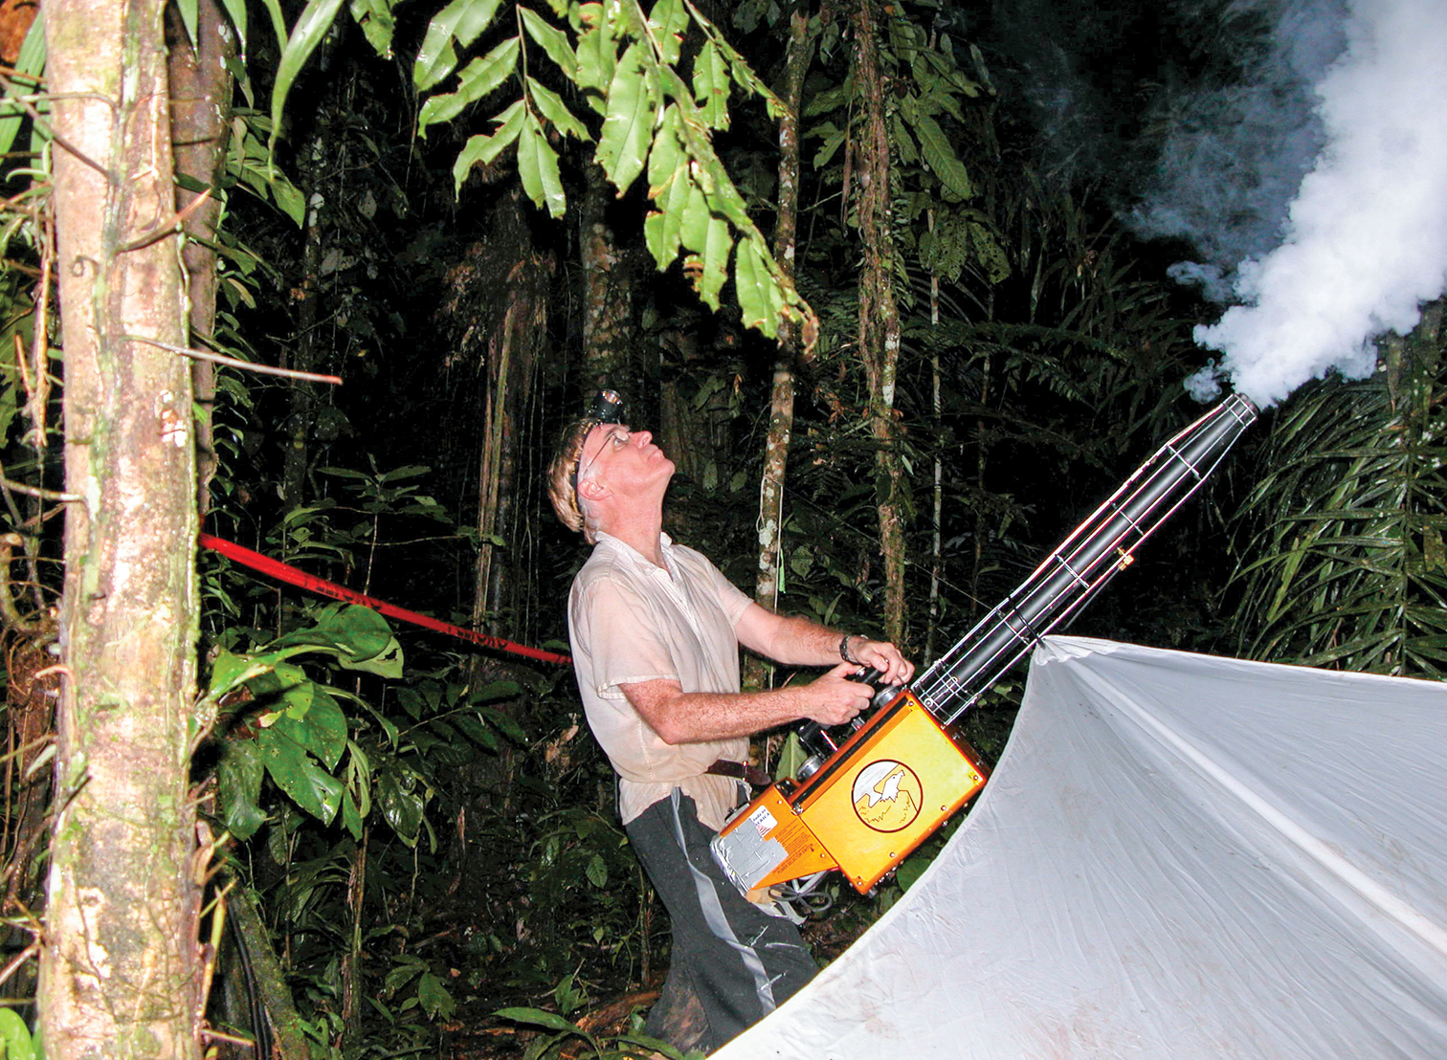
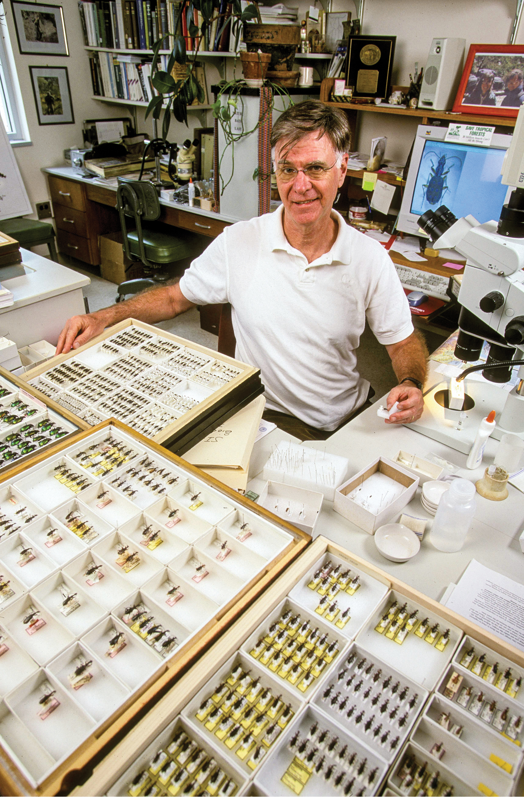
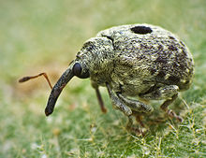
Terry Erwin: 30 million insect species
The 30 million estimate is based on the evaluation of host specificity of guilds in beetle samples, and subsequent hierarchical ratio extrapolations.
Curculionidae
Terry Erwin, 1971

Slide 39

Novotny: Low host specificity of herbivorous insects
Vojtech Novotný
Novotny et al. (2007) Nature

Slide 40
Novotny: Low host specificity of herbivorous insects
Vojtech Novotný
Novotny et al. (2007) Nature

Slide 41
How is biodiversity distributed among organisms
Díaz & Malhi (2022) Annu. Rev. Environ. Res.

Slide 42
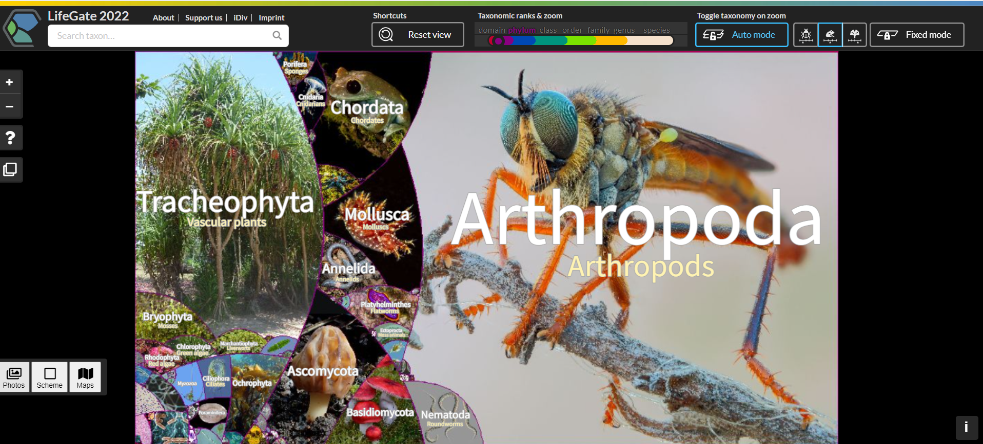
How is biodiversity distributed among organisms
https://lifegate.idiv.de/

Slide 43
The discrepancy among species diversity, phylogenetic diversity, and biomass
Díaz & Malhi (2022) Annu. Rev. Environ. Res.

Slide 44
Seas are dominated by bacteria, archea, and animals. Mainland by plants.
Includes
Diatoms
Includes
Cyanobacteria
Most biomass is terrestrial!
Díaz & Malhi (2022) Annu. Rev. Environ. Res.

Slide 45
Thank you. Questions?

